Slide 1
General Information
Ronan Cummins
room: IT-311 (IT Building)
email: ronan.cummins@nuigalway.ie
website: http://netserver.it.nuigalway.ie/ct246/cs102.htm
Site is linked from Götz Pfeiffer’s page for CS102 (i.e. http://schmidt.nuigalway.ie/cs102/ )
Notes available on site
No labs or assignments (for this section of the course)

Slide 2
CS102 Course Objectives
This course gives a general overview of computer systems, data communication and the Internet.
Assume no prior knowledge of computer technology.
Understand the theory and developments in computer systems.
Introduction to the use of computers.
Notes:
Bigger picture and should compliment computer programming and Algorithms
Hopefully be interesting and some fun

Slide 3
Sections Covered
Introduction (2 weeks)
Data Representation (2 weeks)
Central Processing Unit (1 week)
Data Storage (1 week)
Networks (1 week)
Internet (1 week)
Security (1 week)
Notes:
10 sections
3 areas –, introduction 1-2, hardware 3-7, network/internet 8-10

Slide 4
Course details
Lecture times ( 1 hour per week):
Tuesday 2-3pm AM150
Term 1: 12 weeks (week 4 now!)
Exams:
CS102 final exam in the summer
1 Question on IT in Section C
Notes:
Lectures – notes and listen, should always attend,
No enough to have lecture notes add additional information
No major conversations please and turn off mobiles
I start 10 minutes after and finish 10-5 minutes to hour
Try to break up with quiz or problem
Ask questions during lecture if you want or see me at end of lecture
Some sample attendance sheets
Sit down the front half please
May have term exam at end of first term

Slide 5
Course Resources
Lecture notes available in the Concourse photocopy service
Books in Library:
Stephen Burd – Systems Architecture
– 004.22 BUR – ISBN 0619216921
Capron/Johnson – Computers tools for the Information Age
– 004 CAP – ISBN 0131227238
Notes:
Notes available on concourse but not sufficient to pass exam next Summer
Based on book 8th edition
good introduction book and website with references and exercises
Self register for blackboard

Slide 6
Course web sites
Book web sites for “Systems Architecture”:
http://averia.mgt.unm.edu/sa5e_student
User – “sa5e” and password – “Itanium2”
Notes:
Notes available on concourse but not sufficient to pass exam next Summer
Based on book 8th edition
good introduction book and website with references and exercises
Self register for blackboard

Slide 8
Section 1
Introduction
Notes:
Introduce myself work as an applied teacher of computing in IT department
3rd year in NUIG and 2nd year lecturing this subject
Before this I was a lecturer in GMIT for 2 years
Before that I worked in Nortel Networks as a engineer developing software, customer support, electronic manufacturing, project manager

Slide 9
Introduction
1.1 History of computing
1.2 Components of a computer
1.3 Networks
1.4 Computer categories
1.5 Computer professions
Notes:
Week 1 today and tomorrow is for just introducing the subject
More detailed later in term
Different levels of experience with PCs

Slide 10
1.1 History of computing
Early computers based on mechanical relays
  1940: Stibitz at Bell Laboratories
  1944: Mark I: Howard Aiken and IBM at Harvard
Based on vacuum tubes
  1937-1941: Atanasoff-Berry at Iowa State
  1940s: Colossus: secret German code-breaker
  1940s: ENIAC: Mauchly & Eckert at U. of Penn.

Slide 11
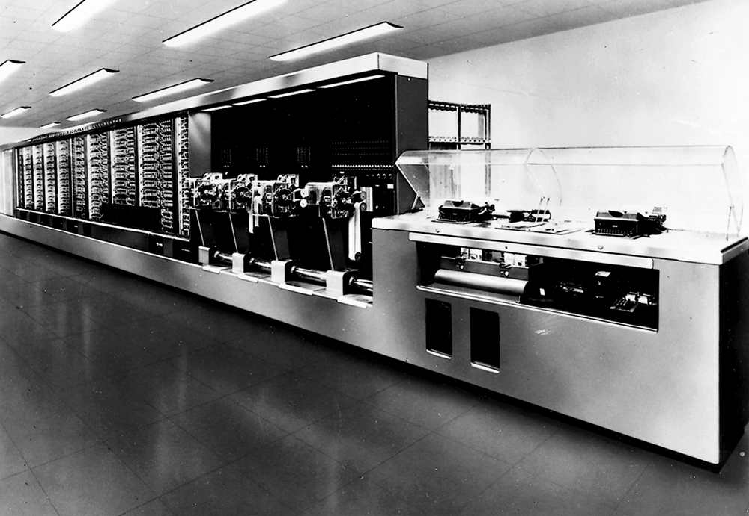
The Mark I computer

Slide 12
Evolution of the computer
1950s, 60s
  Transistor replaced vacuum tube
  Integrated Circuit, assembler languages
  Military and space programs
1970s
  Mini computers IBM, Digital
  Computers owned by Large Organizations
  Punch cards for input, high level languages
1980s
  Microprocessor
  PC desktop, Apple, IBM, DOS, Windows 3.1, Unix
  GUI software, mouse, graphics, OO design
  Variety of standards networks and Operating systems

Slide 13
Evolution of the computer
1990s
  Microsoft dominance
  Consolidation of hardware industry
  Internet growth, fiber optics
  Free source software Linux
  Software – Java C# Windows 95, 98
2000s
  Y2K and dot com bubble
  Internet capacity and eCommerce
  Pocket computers
  SUN/IBM/Motorolla/Apple alternative
  Software - PHP, ASP, Windows 2000, XP

Slide 14
Future directions of IT
Computers becoming smaller and compact
Convergence of PC, phone and TV
Cost reduction in technology
Better organization of Web material
Increases in wireless network capacity
Notes:
Crystal ball
Shrinking of PC
Better resolution screens
Initial cost of design but then becomes commodity
HP laptop project for 2nd years
Different standards for multimeida (RealTime, Quicktime)
Wireless monitoring of patients research here in NUIG

Slide 15
1.2 Computer Components
Hardware
  Equipment associated with the system
Software
  Instructions that tell the hardware what to do
People
  Computer programmer: writes software
  User: purchases and uses software
    Often called end-user
Notes:
Hardware all the physical equipment
Software – instructions that tell computer what to do
Human interaction with computers

Slide 16
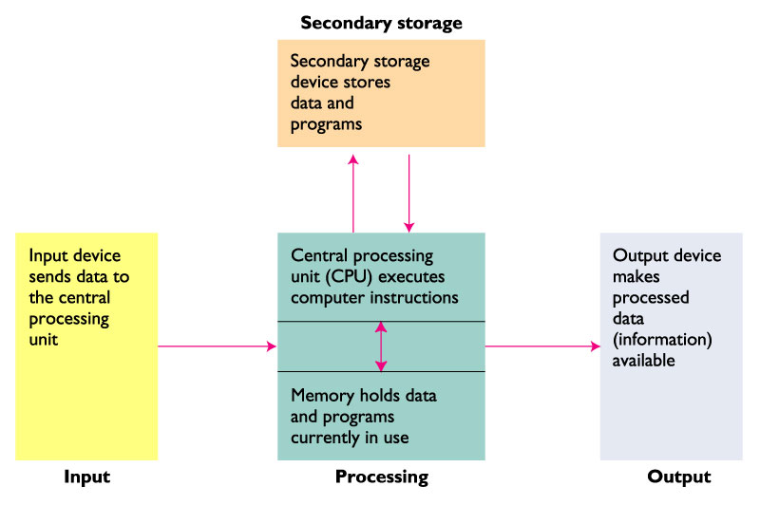
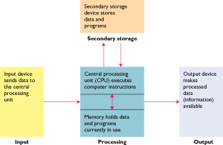
Hardware components
Notes:
Based on human architecture – sensory data, brain –CPU, Software thoughts, communications
Example input changes to Word document and save
Input – accept data from people, CPU – manipulate and display output to people
Same for small and large computers

Slide 17
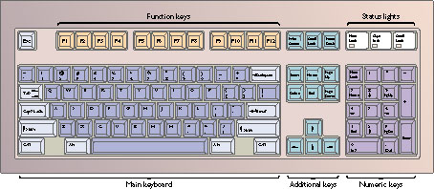
Input: What Goes In
Input: the data put into the computer for processing
Common input devices:
Keyboard - Most common input device
Mouse - Moves over a flat surface
Scanner - Reads letters and symbols
Microphone – Voice recognition
Notes:
Look at hardware arcitecture
Keyboard - Generates electrical signals which are translated into characters. QWERTY keyboard – based on typewriter (US different layout)
Mouse - Movement of mouse ball causes corresponding movement of pointer on screen ( 2 buttons click and options)
Scanner - Wand reader, laser beam, bar code reader often used in stores
Flatbed and sheet-fed scanners scan pictures or printed documents
CAM video recorder, digital camera, microphone for voice activation

Slide 18
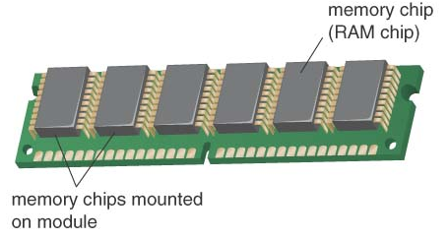
Memory Storage
Used to temporarily hold data
  After it is retrieved from input device and before it is processed
  After it is processed and before it is released to output device
Volatile storage
  Data in memory lost if power is lost or program closed
Random Access Memory
  Implemented with silicon based semiconductor devices
Notes:
Think of the information written on a white board
Called Primary storage
Stores data and program (e.g. Word and document)
RAM for PC, Flash cards camera

Slide 19
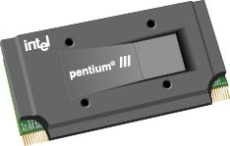
The Processor
Center of activity in the computer
  Consists of electronic circuits
    Interprets and executes program instructions
    Communicates with input, output, and storage devices
Called Central Processing Unit (CPU)
Micro-processor – CPU on 1 silicon chip
Notes:
Brains of computer,
contoller from timing of clock
Intel Celeron, Pentium – Silicon fab in Leixlip
Microprocessor came from cpu on 1 chip

Slide 20
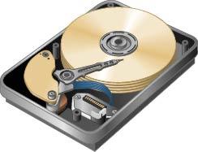
Secondary Disk Storage
Provides long-term storage
  Separate from memory
Common media
  Magnetic disks –hard drive, removable diskette
  Optical disks – CD, DVD
  Magnetic tape
Notes:
If you did transcribe the notes then you have a permanent copy of them
Circular disk uses magnetic material to store data
Hard drive multiple disks enclosed
DVD Digital Video (Versitile) Disc
Laser beam to read (reflect) groves on disk
Removable Memory sticks – USB
Tapes obsolete

Slide 21
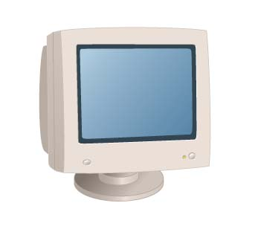
Output
Output: the result produced by the CPU
Common output devices:
  Screen (monitor): can display text, numbers, photographs, even video, in full color
CRT Cathode Ray Tube
LCD Liquid Crystal Display
  Printers produce paper printout
  Speakers for sound output
Notes:
CRT screen Stream on electrons from gun which hits phosphorous coating on screen. Needs to be refreshed called scan rate (Each dot referred to as Pixel)
LCD Liquid crystal display also used on labtops. Thin film technology
17 inch screen diagonal
Printers – Laser (light beam) and ink jet (cheaper use spray from ink carthridge)

Slide 22
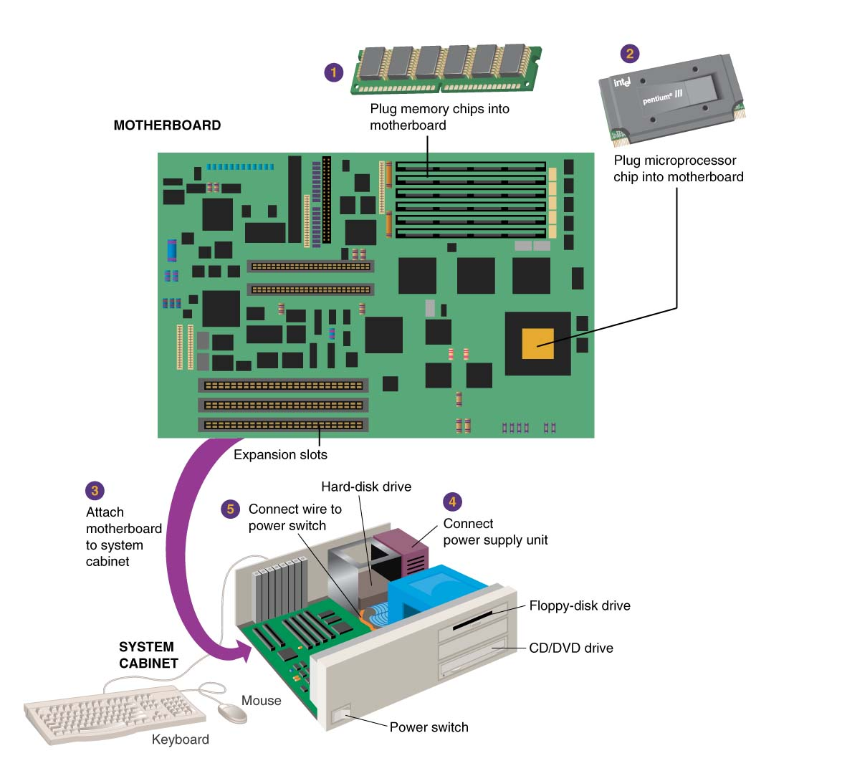
Computer motherboard hardware
Notes:
Under cover of PC – Motherboard joins components with tracks busses – laptop same structure but smaller
1 – memory chip added to connectors
2 – CPU added to connector + heat sink socket
3 – Motherboard attached to cabinet
4 – power supply (transformer) and fan for cooling
Disk drives connect by ribbon cable
Mouse keyboard connections + USB Universal Serial Bus (automatic detection) + serial connector (D type)
Connect components using buses (data and address)
Cabinet horizontal or tower vertical

Slide 23
You still need the software!
Operating System or System software
Helps the computer perform essential operating tasks and enables the application software to run
e.g. Microsoft Windows XP, Linux, Unix, Mac OS
and…
Application software
Enables you to perform specific tasks--solve problems, perform work, or entertain yourself
e.g. Microsoft Office, Explorer
Notes:
OS e.g. Windows 2000 in college, XP and Applications e.g. Word Excel
OS runs in background – loads programs, communicate over network, control hardware,
Application Programs cannot be used without an Operating System.
Application Programs must be compatible with the Operating System.
Special software developed using programming languages

Slide 24
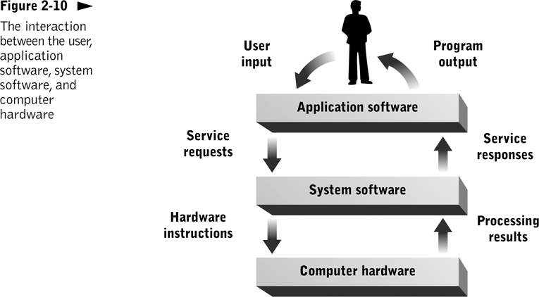
Notes:
Operating System is translater or middle man

Slide 25
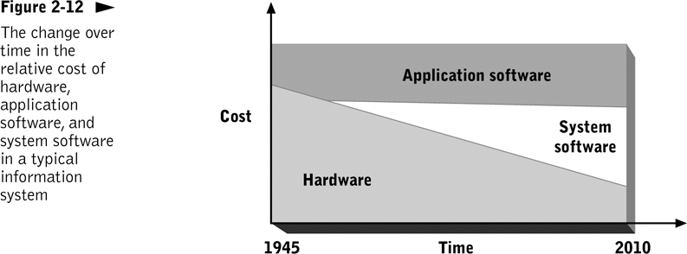
Notes:
Software more expensive as it is often unique and not massed produced

Slide 26
1.3 Networks
Network: a system that uses communications equipment to connect computers and their resources
Personal computers in an office are connected so users can communicate
  Users can operate computers independently
  Can share resources and exchange data
Notes:
Section in itself
LAN – local area network (like in NUIG) vs WAN wide area network (Internet)
Examples student accommodation includes access to network, Wireless network in IT building
PCs have network card NIC Network Interface Card and cabled back to switch in lab, wireless NIC base stations

Slide 27
The Internet
Internet - a worldwide network that connects hundreds of thousands of smaller networks.
Cyberspace encompasses the space of electronic movement.
Connects different computer systems world wide with standard agreed communication rules
Notes:
None owns it – originally developed by US depart of defence (not commercially designed)
Internet - a worldwide network that connects hundreds of thousands of smaller networks.
Used for transferring email
Information broken into packets each one travels indivually with address

Slide 28
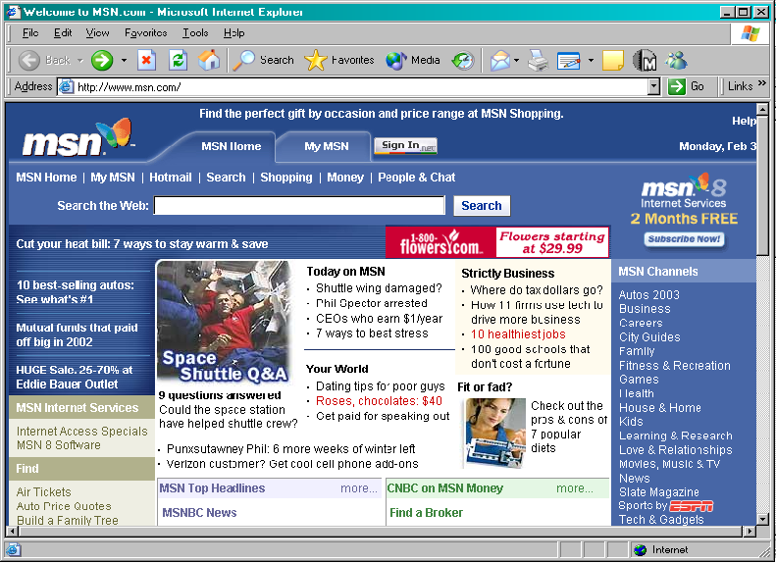
The World Wide Web
A subset of the Internet
  Actually, a standard for displaying and transmitting information
Web site: a location on the Web “URL”
  Home page: the main page of a Web site
Notes:
The World Wide Web - multimedia part of Net
Universal Resource Locator – used by browsers application runs on client PC to see the web
Information not organized
Hypertext links between documents
Information overload
Microsoft – Explorer, Netscape Navigator, Gonzilla
HTML – Hyper text markup language displayed by browser

Slide 29
1.4 Computer categories
Personal computers
Notebooks
Handheld devices
Embedded computers
Servers
Main Frames
Notes:
Boundary between categories is blurring and changing

Slide 30
Personal Computers
Desktop computer for single user
  Also known as PCs, microcomputers, or home computers
Broken down into three categories:
  Low-end computers
  Fully-powered personal computers
  Workstations
Network computer
  Central processing unit and minimal memory
  Designed to be used on a network
    Sometimes called thin client
Notes:
Different user categories – Home and business grew in 90’s
Traditionally separated by OS run (Apple/Microsoft)
Dominance on Windows/Intel vs Apple/IBM/Motorolla/SUN
Low end – home access to internet and games – browsing, word processing
Mid range – business office (high memory and network performance)
Workstations – CAD design (graphics, speed, storage space) Games multimedia
Network computer SUN vision of thin client – hit by cheaper PCs, Now WebTV
Vendors – Dell, Fujitsu/Siemens, IBM
Cost dropping and speed/storage increasing

Slide 31
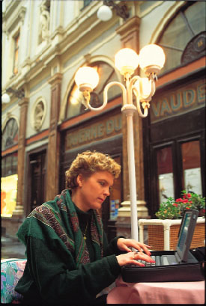
Notebook/Laptop Computers
Small, lightweight computers
Battery powered/wireless access
Capabilities approach that of desktop computers
  Similar processing and memory
  Most have hard disk and CD-DVD drive
Typically more expensive than comparable desktop computers
Notes:
Also called Laptops
Weight issue
Runs same operating systems and applications as PCs
Vendors – Dell, IBM, HP, Fujitsu, Siemens (same as PC)
Docking station back at base

Slide 32
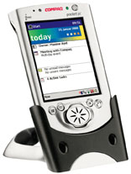
Handheld Computers
Personal Digital Assistant (PDA)
  Keeps track of appointments, contacts, Accepts input with hand-held stylus
Pocket PC
  Offers capabilities of PDAs, plus the ability to run stripped-down versions of software such as word processing and spreadsheets
Internet phones
  Email, web services and videos by wireless transmission
Notes:
Also called PalmTop “PalmOS” – PalmSoft vs Windows Consumer Electronics OS
Originally a diary but now merging with phone
MAC iPod in this category MP3 format download from internet
USB – Docking station for synchronising
Email for business person on the road - Blackberry
Stylus pen or folding keyboard
Vendors PC - Apple, Dell and phones Nokia Motorolla
Bluetooth protocol

Slide 33
Embedded Computer Systems
Does one specific task only
House hold appliances
Industrial controllers
Digital cameras, mobile phones
Game players
Sometimes referred to as micro-controller or real time systems
Notes:
More linked to hardware specific program to do one job
No user interface
Real time systems respond in real world critical minute time
No display or input usually runs in the background and minimum memory
Motorolla microprocessor PowerPC
Robotics

Slide 34
Midrange Computers - servers
Multi-user computers designed to serve the needs of medium-sized organizations
  Hundreds of users connected over a network
  Used for inventory, order-entry, and other company-wide applications (databases)
  Shares file storage and printers for users
  Host web sites or email
Notes:
IT department have our own servers
Vendors HP, IBM, SUN, Dell
OS – Microsoft server vs Linux/Unix
Special room

Slide 35
Mainframes
Very large and powerful computers
  Capable of processing billions of instructions per second
  Capable of handling billions of characters of data
Often used for applications with many users
  Reservations systems
  Large mail-order houses – large eCommerce site
  E-mail servers
  Banking
Backup and security for critical applications
Notes:
IBM big blue dominates
Governments and banks very secure systems
Limited access to internet
Also SUN HP
Special secure computer rooms

Slide 36
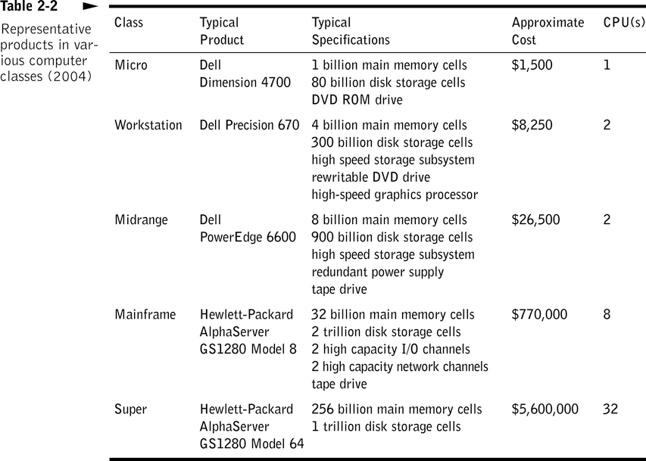

Slide 37
1.5 Computer professionals
Most organizations have some sort of information technology department
  Made up of people who are responsible for the organization’s computer resources
  Maintain data and provide services to end users
Can be called MIS, IS, Computer Services
IT in organization may be outsourced or it may provider IT services or products
Notes:
Computer services – NUIG support
IT department 2 support people “Joe O’Connell and Peter O’Keane”
Some organisations are IT companies (HP, Nortel) other are not but have IT dept to support business (Boston Scientific)

Slide 38
Computer People
Data entry operators prepare data for processing
Computer operators monitor systems, keep peripherals running, and make backups
System administrators
Network engineers implement and maintain organization’s network(s)
Technical sales
Notes:
Small companies may have 1 persons doing support to users and running operation
System admin – add users , disk space
Security – firewall
Maplin and CK sales

Slide 39
More Computer People
Systems analysts plan and design entire systems
Programmers design, write, test, implement, and maintain computer programs
User Training
Customer support
Chief Information Officer (CIO) makes key technology decisions
Notes:
Systems analysts - Must have knowledge in programming, as well as knowledge of the business
People support users bridge between users and new technology
Call centers, field support for hardware and applications
Top manager responsible for IT

Slide 40
Section 2
Data Representation
Notes:
Introduce myself work as an applied teacher of computing in IT department
3rd year in NUIG and 2nd year lecturing this subject
Before this I was a lecturer in GMIT for 2 years
Before that I worked in Nortel Networks as a engineer developing software, customer support, electronic manufacturing, project manager

Slide 41
Data Representation
2.1 Binary data
2.2 Data Standards
2.3 ASCII Standard
2.4 Multimedia representation
2.5 Memory addresses
Notes:
Week 1 today and tomorrow is for just introducing the subject
More detailed later in term
Different levels of experience with PCs

Slide 42
2.1 Binary data
Bit = Binary Digit = a symbol whose meaning depends on the application at hand.
Some possible meanings for a single bit
  Numeric value (1 or 0)
  Boolean value (true or false)
  Voltage (high or low)
Notes:
Computers complex but based on on/off logic

Slide 43
Byte
A group of 8 bits
  Each byte has 256 (2⁸) possible values
For text, stores one character
  Can be letter, digit, or special character
Memory and storage devices measured in number of bytes
Notes:
1K memory = 2 power 10 = 1024Bytes

Slide 44
Terminology for data sizes
Byte - 1 byte of data
Kilobyte (KB) - ~1000 bytes
  Kb ~ 1000 Bits
Megabyte (MB) - ~1,000,000 bytes
Gigabyte (GB) - ~1 billion bytes
Terabyte (TB) - ~1 trillion bytes
Notes:
Examples
2.6GHz CPU speed cycles per second
512MBytes RAM memory size
80GBytes Hard drive storage
56K Modem bits per second

Slide 45
Word
The number of bits the CPU processes as a unit
  Typically a whole number of bytes
  The larger the word, the more powerful the computer
  Personal computers typically 32 or 64 bits in length

Slide 46
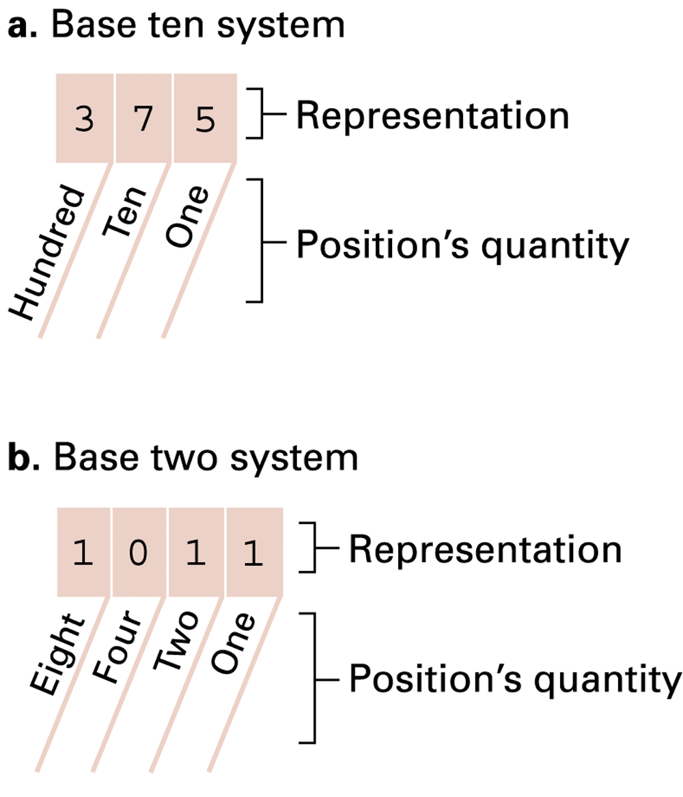
The base ten and binary systems

Slide 47
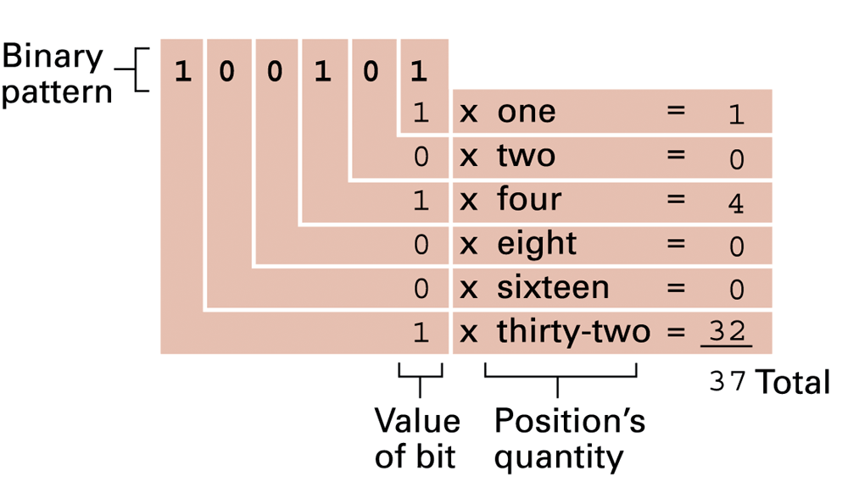
Decoding the binary representation 100101

Slide 48
Data Representation
Binary equivalent of decimal numbers
Decimal | Binary
0 | 0000
1 | 0001
2 | 0010
3 | 0011
4 | 0100
5 | 0101
6 | 0110
7 | 0111
8 | 1000
9 | 1001
10 | 1010

Slide 49
Hexadecimal Notation
Uses 16 as its base or radix
(hex = 6, and decimal = 10)
Compact; advantage over binary notation
Often used to designate memory addresses

Slide 50
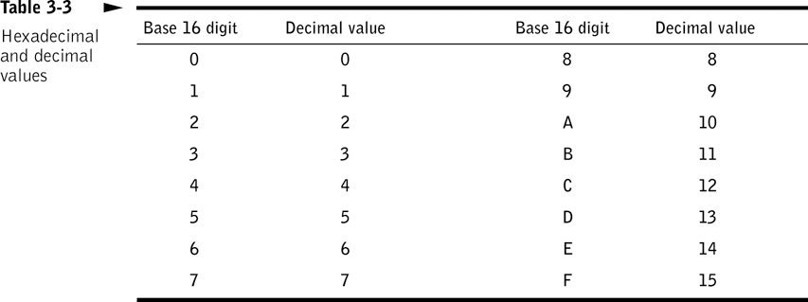

Slide 51
Digital vs. Analog (1)
Computing systems are finite machines. They store a limited amount of information, even if the limit is very big.
  The goal, is to represent enough of the world to satisfy our computational needs and our senses of sight and sound.
  The information can be represented in one or two ways: analog or digital.
Analog data is a continuous representation, analogous to the actual information it represents.
  In example, a mercury thermometer is an analog device. The mercury rises in a continuous flow in the tube in direct proportion to the temperature.
Digital data is a discrete representation, breaking the information up into separate (discrete) elements.
  Computers can’t work with analog information, so a need do digitize the analog information arise. This is done by breaking the analog information into pieces and representing those pieces using binary digits

Slide 52
Digital vs. Analog (2)
Why digital signal?
  Both electronic signals (analog and digital) degrade as they move down a line. The voltage of the signal fluctuates due to environmental effects.
  As soon as an analog signal degrades, information is lost. Since any voltage level within the range is valid, it is impossible to know that the original signal was even changed
  Digital signals jump sharply between two extremes (high and low state). A digital signal can degrade quite a bit until the information is lost, because any value over a certain threshold is considered high value and bellow the threshold is considered low value

Slide 53
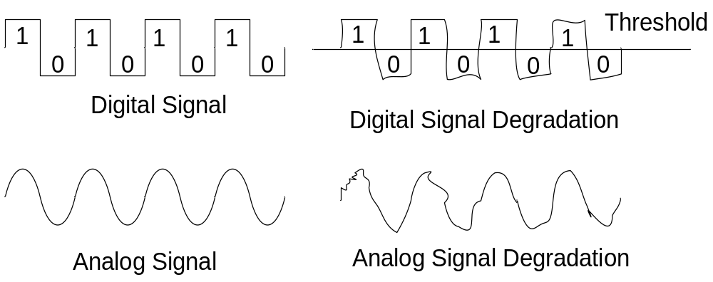
Digital vs. Analog (3)
You can still retrieve the information from a reasonably degraded digital signal
Periodically a digital signal is reclocked to regain its original shape. As long as it is reclocked before too much degradation, no info is lost.

Slide 54
Binary Representation (1)
Why binary representation (as suppose to decimal or octal, etc..)?
  Because the devices that store and manage the digital data are far less expensive and complex for binary representation.
  They are also far more reliable when they have to represent one out of two possible values.
  Because the electronic signals are easier to maintain if they carry only binary data.

Slide 55
Binary Representation (2)
One bit can be either 0 or 1. Therefore, one bit can represent only two things.
To represent more than two things, we need multiple bits. Two bits can represent four things because there are four combinations of 0 and 1 that can be made from two bits: 00, 01, 10,11.
In general, n bits can represent 2^{n} things because there are 2^{n} combinations of 0 and 1 that can be made from n bits. Note that every time we increase the number of bits by 1, we double the number of things we can represent.

Slide 56
2.2 Data Format Standards
Meaning of internal representation must be appropriate for the type of processing to take place:
  i.e. Images & sound: have to be digitized
    Images – need detailed description of the data, how color is represented at each data point
    Sound – need sampling rate
Proprietary formats
  Unique to a product or company
  E.g., Microsoft Word, Corel Word Perfect, IBM Lotus Notes
Standards
  Evolve two ways:
    Proprietary formats become de facto standards (e.g., Adobe PostScript, Apple Quick Time)
    Committee is struck to solve a problem (Motion Pictures Experts Group, MPEG)

Slide 57
Why Standards?
They exist because they are:
  Convenient – sometimes the time to market is very important whenever trying to finish a product, therefore existing standards may be used to save time elaborating own protocols and interfaces
  Efficient – most of the standards are put together by committees with a wide experience in the specific area
  Flexible – usually the standards allow for manufacturer or OEM specific extensions
  Appropriate – address a specific problem in a specific domain
Allow communication and sharing of information
Allow computing systems and software to interoperate (at both hardware and software levels)
Sometimes standards are arbitrary and have some “blast from the past” (due to historical evolution)

Slide 58
Standards Organizations
ISO – International Standards Organization
CSA – Canadian Standards Association
ANSI – American National Standards Institute
IEEE – Institute for Electrical and Electronics Engineers

Slide 59
Examples of Standards
Type of Data | Standards
Alphanumeric | ASCII, Unicode
Image | JPEG, GIF, PCX, TIFF, BMP, etc
Motion picture | MPEG-2, Quick Time, MPEG-4, etc
Sound | Sound Blaster, WAV, AU, MP3, etc..
Outline graphics/fonts | PostScript, TrueType, PDF

Slide 60
2.3 ASCII Standard
ASCII - Stands for American Standard Code for Information Interchange
Standard for representing printable characters (English language keyboard) in binary values (7 bits per character)
Used on virtually all personal computers

Slide 61
ASCII Features
7-bit code
8th bit is unused (or used for a parity bit)
2⁷ = 128 codes
Two general types of codes:
  95 are “Graphic” codes (displayable on a console)
  33 are “Control” codes (control features of the console or communications channel)

Slide 62
The message “Hello.” in ASCII

Slide 63
“Hello, world” Example
H
e
l
l
o
,
w
o
r
l
d
=
=
=
=
=
=
=
=
=
=
=
=
Binary
01001000
01100101
01101100
01101100
01101111
00101100
00100000
01110111
01100111
01110010
01101100
01100100
=
=
=
=
=
=
=
=
=
=
=
=
Hexadecimal
48
65
6C
6C
6F
2C
20
77
67
72
6C
64
=
=
=
=
=
=
=
=
=
=
=
=
Decimal
72
101
108
108
111
44
32
119
103
114
108
100
Note: 12 characters – requires 12 bytes
Each character requires 1 byte

Slide 64
“4+15” Example
=
=
=
=
Binary
00110100
00101011
00110001
00110101
=
=
=
=
Hexadecimal
34
2B
31
35
=
=
=
=
Decimal
52
43
49
53
4
+
l
5
“4+15” is “00110100 00101011 00110001 00110101”
or “34₁₆2B₁₆31₁₆35₁₆”

Slide 65
Unicode
Designed to accommodate alphabets of more than 256 characters
Uses 16 bits to represent one character
  65,536 possible values
Requires twice as much space to store data
Notes:
Different cultures use different alphabets Chineese, East European, French, Even Irish

Slide 66
2.4 Multimedia Representation
Sound is perceived when a series of air compressions vibrate a membrane in our ear, which sends signals to our brain
A stereo sends an electrical signal to a speaker to produce sound. This signal is an analog representation of the sound wave. The voltage in the signal varies in direct proportion to the sound wave
To digitize the signal we periodically measure the voltage of the signal and record the appropriate numeric value. The process is called sampling
In general, a sampling rate of around 40,000 times per second is enough to create a very good high quality sound reproduction

Slide 67
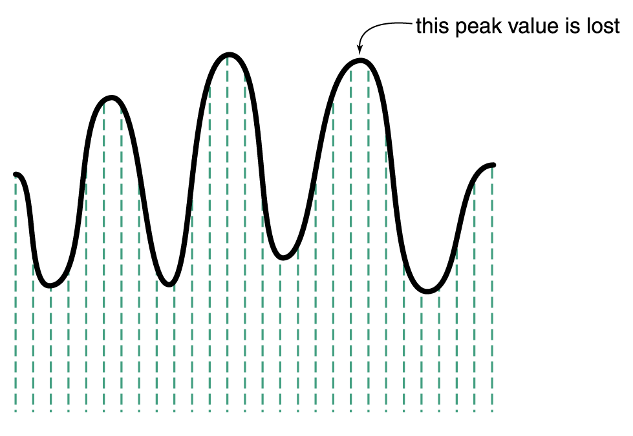
Audio Information Representation
Sampling an audio signal

Slide 68
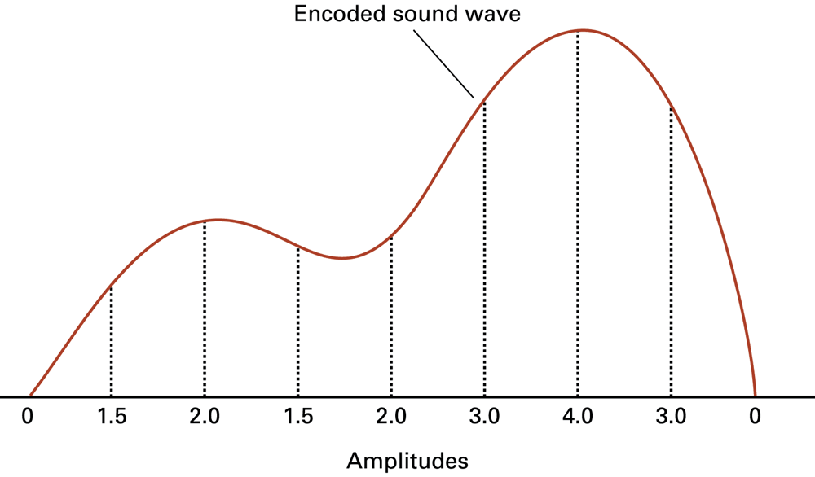
The sound wave represented by the sequence 0, 1.5, 2.0, 1.5, 2.0, 3.0, 4.0, 3.0, 0

Slide 69
Audio Formats
Several popular formats are: WAV, AU, AIFF, VQF, and MP3. Currently, the dominant format for compressing audio data is MP3.
MP3 is short for MPEG-2, audio layer 3 file.
MP3 employs both lossy and lossless compression.
  Analyzes the frequency spread and compares it to mathematical models of human psychoacoustics (the study of the interrelation between the ear and the brain) and it discards information that can’t be heard by humans.
  Then the bit stream is compressed using a form of Huffman encoding to achieve additional compression.

Slide 70
Representing Images and Graphics (1)
Color is our perception of the various frequencies of light that reach the retinas of our eyes
Our retinas have three types of color photoreceptor cone cells that respond to different sets of frequencies.
  These photoreceptor categories correspond to the colors of red, green, and blue
Color is often expressed in a computer as an RGB (red-green-blue) value, which is actually three numbers that indicate the relative contribution of each of these three primary colors
For example, an RGB value of (255, 255, 0) maximizes the contribution of red and green, and minimizes the contribution of blue, which results in a bright yellow

Slide 71
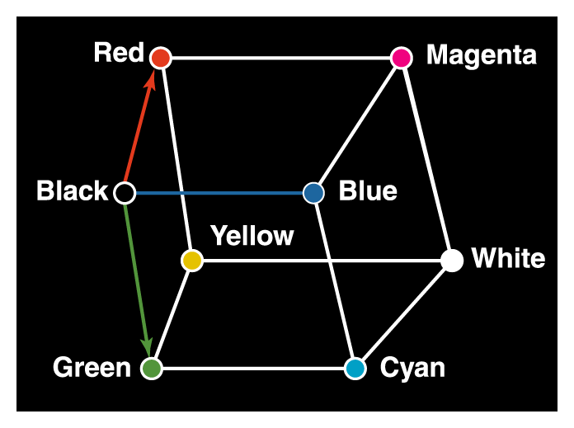
Representing Images and Graphics (2)
Three-dimensional color space

Slide 72
Representing Images and Graphics (3)
The amount of data that is used to represent a color is called the color depth.
HiColor is a term that indicates a 16-bit color depth.
  Five bits are used for representing the R and B components.
  Six bits are used for representing the G component, because the human eye is more sensitive to G;
TrueColor indicates a 24-bit color depth. Therefore, each number in an RGB value is represented using eight bits.

Slide 73
Representing Images and Graphics (4)
RGB Value |  |  | Color
Red | Green | Blue
0 | 0 | 0 | black
255 | 255 | 255 | white
255 | 255 | 0 | yellow
255 | 130 | 255 | Pink
146 | 81 | 0 | brown
157 | 95 | 82 | purple
140 | 0 | 0 | maroon

Slide 74
Digitized Images and Graphics
Digitizing a picture is the act of representing it as a collection of individual dots called pixels.
The number of pixels used to represent a picture is called the resolution.
The storage of image information on a pixel-by-pixel basis is called a raster-graphics format.
  Several popular raster file formats including bitmap (BMP), GIF, and JPEG.

Slide 75
Vector Graphics
Instead of assigning colors to pixels as we do in raster graphics, a vector-graphics format describe an image in terms of lines and geometric shapes.
  A vector graphic is a series of commands that describe a line’s direction, thickness, and color. The file size for these formats tend to be small because every pixel does not have to be accounted for.
Vector graphics can be resized mathematically, and these changes can be calculated dynamically as needed.
However, vector graphics is not good for representing real-world images.

Slide 76
Representing Video
A video codec Compressor/De-compressor refers to the methods used to shrink the size of a movie to allow it to be played on a computer or over a network.
  Almost all video codecs use lossy compression to minimize the huge amounts of data associated with video.
Two types of compression: temporal and spatial.
Temporal compression looks for differences between consecutive frames. If most of an image in two frames hasn’t changed, why should we waste space to duplicate all of the similar information?
Spatial compression removes redundant information within a frame.
  For instance, a line compression algorithm, instead of representing a white line as a series of dots with individual color info, it can represent it as how many dots of white color (saving storage space)
  This problem is essentially the same as that faced when compressing still images.

Slide 77
2.5 Main memory addresses
Cells = manageable units (typically 8 bits) into which a computer’s main memory is arranged.
High-order end = the left end of the conceptual row in which the contents of a cell are laid out.
Low-order end = the right end of the conceptual row in which the contents of a cell are laid out.
  Least significant bit = the last bit at the low-order end.

Slide 78
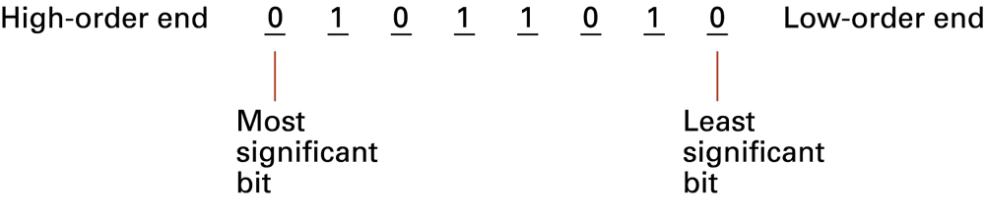
The organization of a byte-size memory cell

Slide 79
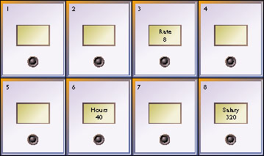
Memory Addresses
Each memory location has an address
  A unique number, much like a mailbox
RAM
  Memory where any cell can be accessed independently
Referred to by number
  Programming languages use a symbolic (named) address, such as Hours or Salary

Slide 80
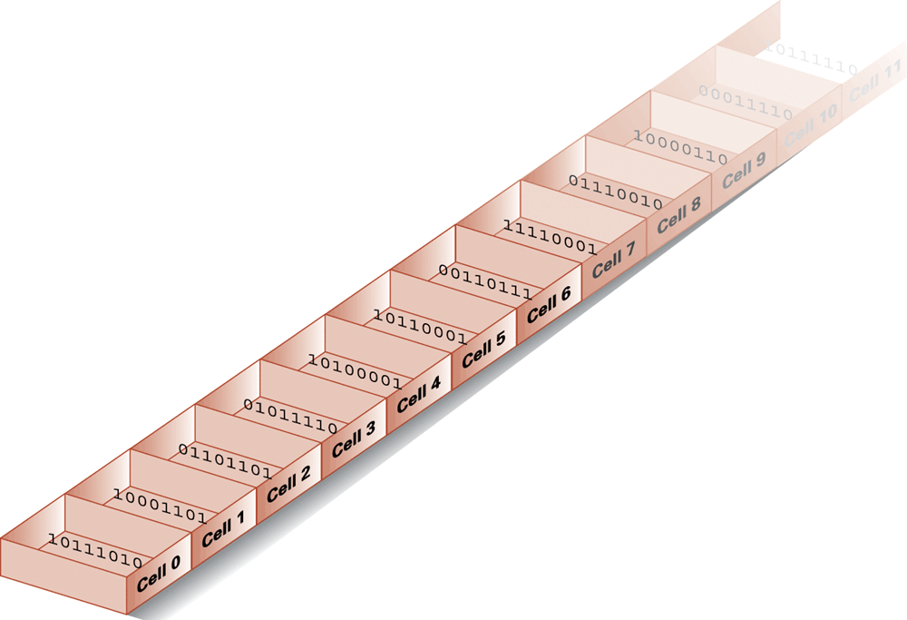
Memory cells arranged by address

